Slide 1


ADVOCATING FOR MITIGATION OF THE CONSEQUENCES OF ALCOHOL ABUSE ON YOUNG PEOPLE IN SCHOOLS
Supporting or publically recommending the action of reducing the effect of alcohol abuse on young people in schools

Slide 2

Definitions
Advocating (publicly recommend or support.)
mitigating(having the effect of making something bad less severe, serious, or painful or lessening the gravity of an offence or mistake.)
Consequences (a result or effect, typically one that is unwelcome or unpleasant.)
Alcohol (is a psychoactive substance with dependence producing properties. The substance has been used as a beverage by many cultures around the world for thousands of years (McGovern, 2009). )
Alcohol abuse (the habitual excessive use of alcohol.)
Definitions of young people typically focus on the ages 14–25, although it has been claimed that these boundaries are being extended in both directions as transitions into adulthood become more protracted (Rutter and Smith, 1995; Rutter et al., 1998; Ward, 1998). T

Slide 3
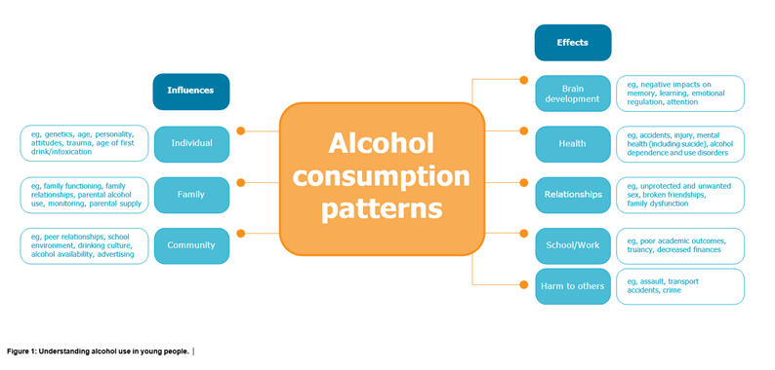
CONSEQUENCES OF ALCOHOL ABUSE
ON YOUNG PEOPLE IN SCHOOLS

Slide 4
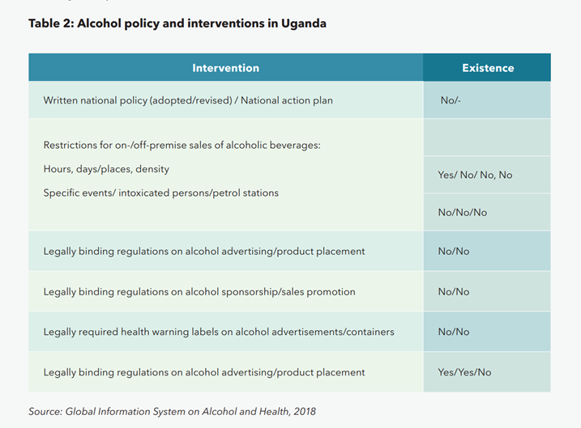

Slide 5
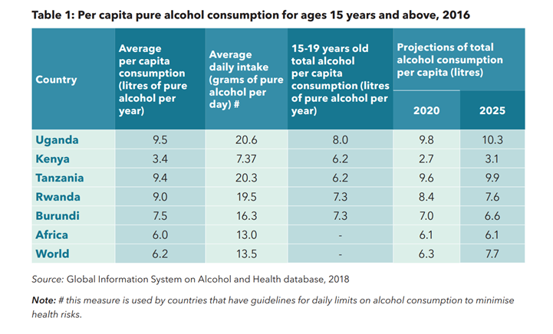

Slide 6
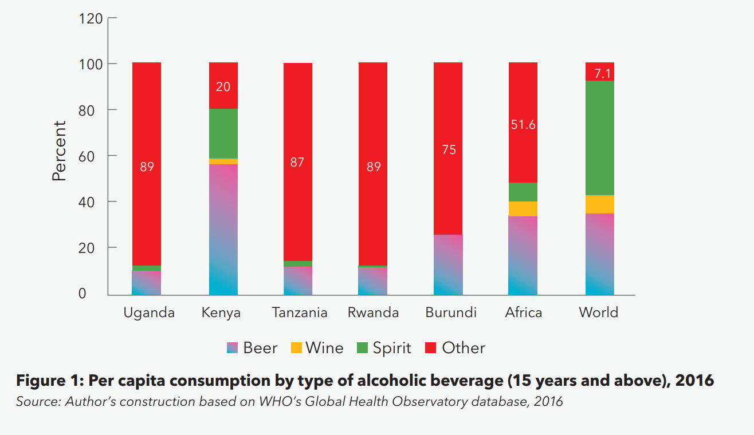

Slide 7
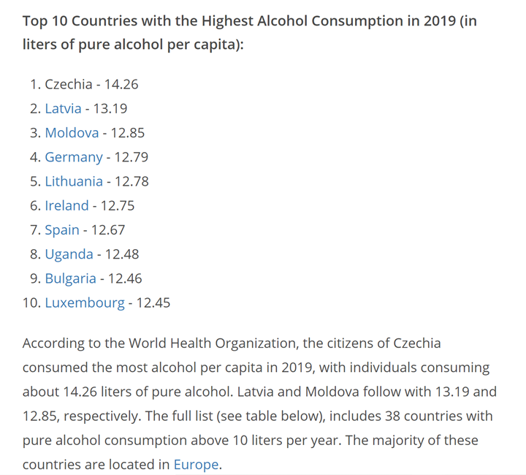

Slide 8
Mitigation measures to advocate for in alcohol abuse for young people in schools
Implementation of The national education sector response ecosystem.
GOOD POLICY AND PRACTICE IN EDUCATION SECTOR RESPONSES TO alcohol abUSE.

Slide 9
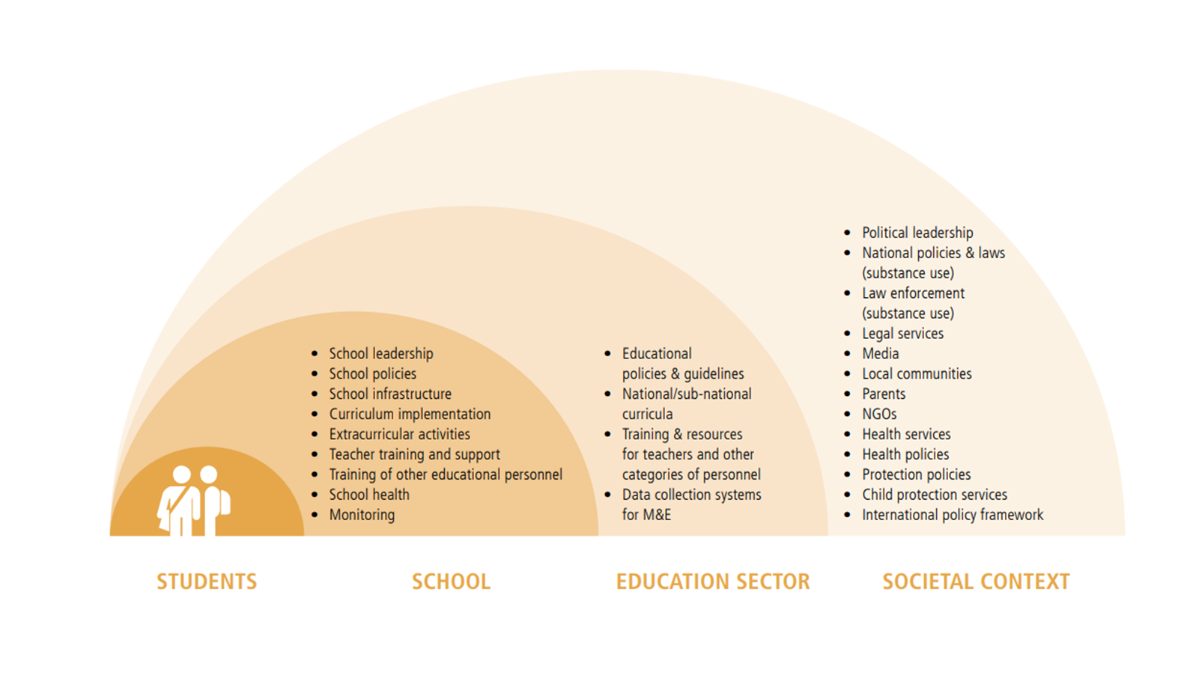
The national education sector response ecosystem.

Slide 10
A policy framework to prevent and address alcohol use among children and young people; National and/or subnational curricula (contents and methods for the delivery of those contents) including skills-based prevention education; Training and support for teachers, school health practitioners and other school staff to plan, develop and implement a comprehensive school-based intervention strategy;
Evidence-based interventions related to curricula implemented in educational institutions.
Evidence-based interventions related to the school environment implemented in educational institutions, including substance use policies in schools, as well as other evidence-based prevention interventions delivered in the context of educational institutions;

Slide 11
School health services, providing both prevention and care and support for young people who use alcohol;
Management, coordination and evaluation of the response in the education sector, including monitoring of prevalence of substance use among children and young people.

Slide 12
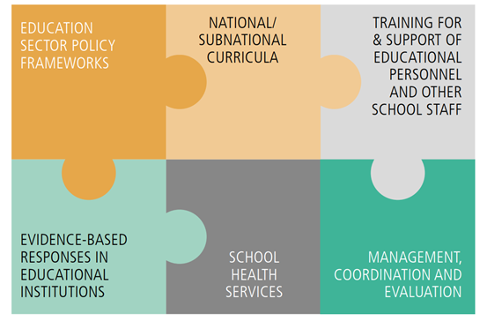
elements of a comprehensive education sector response to alcohol use
Notes:
If they are undertaken together, these elements are most likely to produce positive results on substance use during
adolescence and beyond, protecting students from alcohol use and other risky behaviours through adulthood.

Slide 13
GOOD POLICY AND PRACTICE IN EDUCATION SECTOR
RESPONSES TO alcohol USE
A comprehensive education sector response to alcohol use does not always require more resources. Sometimes re-allocating existing resources and using them more effectively by doing things differently can be just as effective.
In other cases, effective actions may require some investment of new resources.
Decision-makers need to weigh any new costs against the costs of doing nothing, or doing something poorly.
Set goals relevant to the prevalence and patterns of alcohol use among young people.

Slide 14
Set goals relevant to the prevalence and patterns of alcohol use among young people.
WHERE ALCOHOL USE HAS NOT BEGUN
WHERE ALCOHOL USE HAS BEGUN
WHERE ALCOHOL USE AND HARMFUL USE IS COMMON
Prevent the onset of alcohol use
Delay the onset of alcohol use
Reduce alcohol use
Prevent alcohol use disorders
PROVIDE SCREENING, BRIEF INTERVENTION AND REFERRAL FOR TREATMENT
PREVENT AND MITIGATE THE CONSEQUENCES OF ALCOHOL USE

Slide 15
Strategies to reduce and eradicate alcohol abuse in young people in schools
To date, Uganda's strategy on reducing adolescent drinking should focus on targeting influencers (including parents); supporting communities to change norms around supply of alcohol; and minimising harm by changing patterns of drinking behaviour among 11 to 24-year-olds already consuming alcohol.
It is important to focus on wellbeing and the protective factors that help young people to thrive. While there are many factors that contribute to wellbeing, research shows that lifting our levels of belonging, connectedness (including cultural connectedness) and sense of identity are especially important for young people. For example, research shows the importance of engagement in culture and family connectedness as being key to higher levels of wellbeing among youth

Slide 16
continuation
We also know that a critical step in decreasing alcohol harm, for young people and more generally, involves developing more positive social norms and supportive environments around alcohol use within our society. This could be achieved by implementing evidence-based policies which strengthen restrictions on alcohol availability, increase the cost of alcohol, and restrict alcohol advertising and sponsorship.
Facilitating health promotion activities that support wellbeing and create healthy social environments will help to reduce a range of health harms, including alcohol consumption.

Slide 17
References for the presentation
Understanding alcohol use and subsequent harms in young people by Health Promotion Agency
Alcohol consumption among youth in uganda: why policy intervention is necessary by Brian Sserunjogi.
Teenage kicks? Young people and alcohol: a review of the literature by Tim New burn and Michael Shiner Public Policy Research Unit.
Global status report on alcohol and health 2018 World Health Organization.
Good policy and practice in health education: Education sector responses to the use of alcohol, tobacco and drugs UNESCO UNODC & WHO
The effects of alcohol consumption on student life at a rural campus

Slide 18
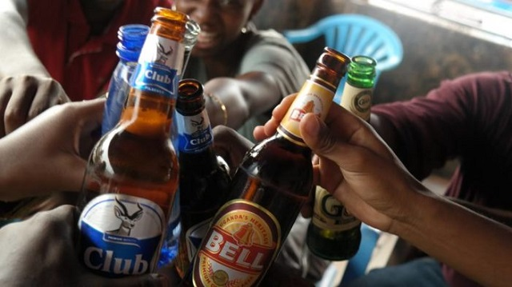
Thank you

